Slide 1

Git-Tix
Microservice Architecture based Ticket listing and selling platform.
Tech Stack: MERN, Docker, Kubernetes, Github Action, NATS
Name: Shubhansu Kr Singh
Roll : 59 RegNo: 12104991

Slide 2
Client

Slide 4
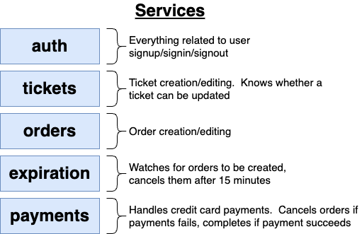


Slide 5
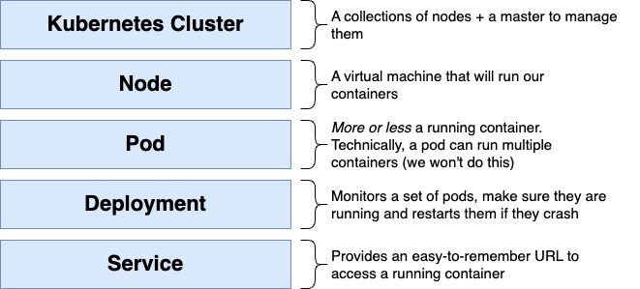
K8s

Slide 6
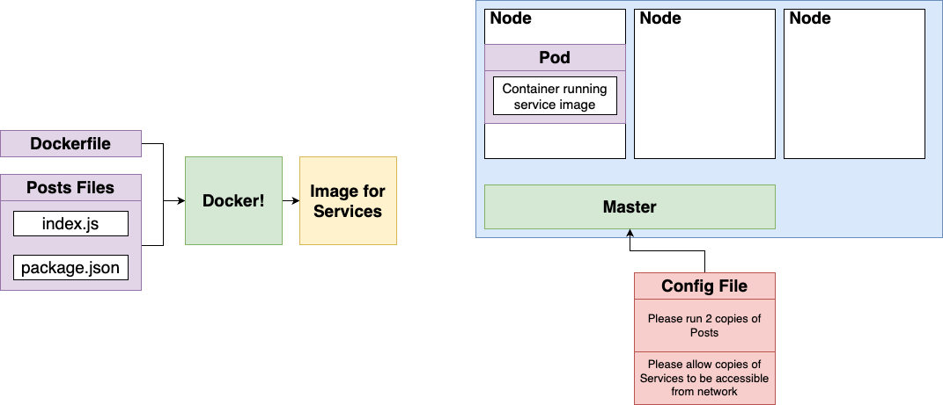
Pods

Slide 7
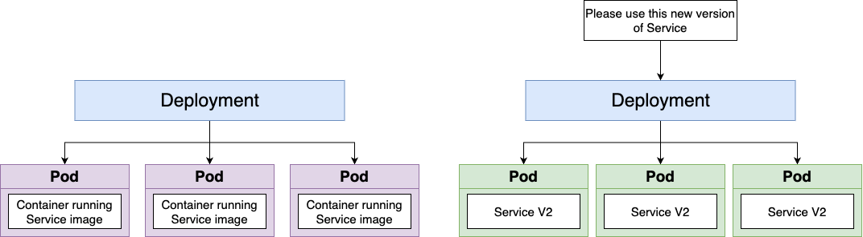
Deployments

Slide 8
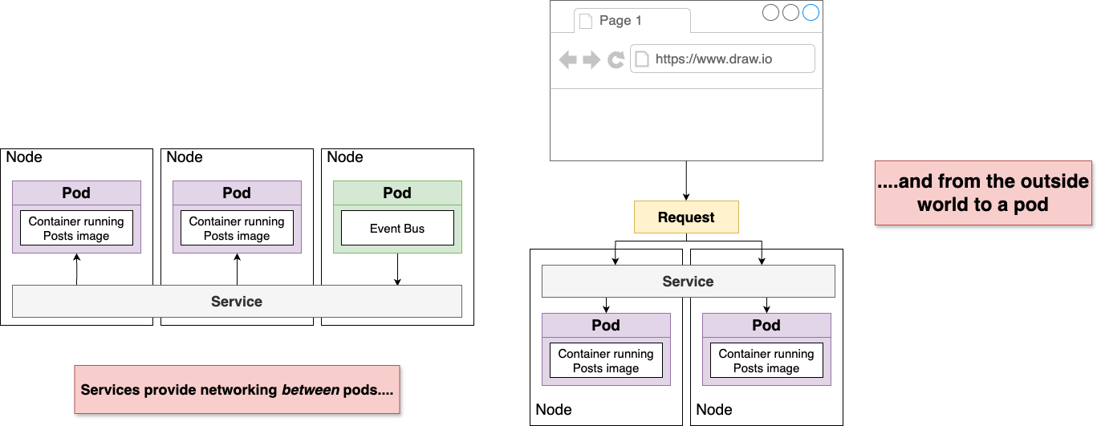
Services

Slide 9
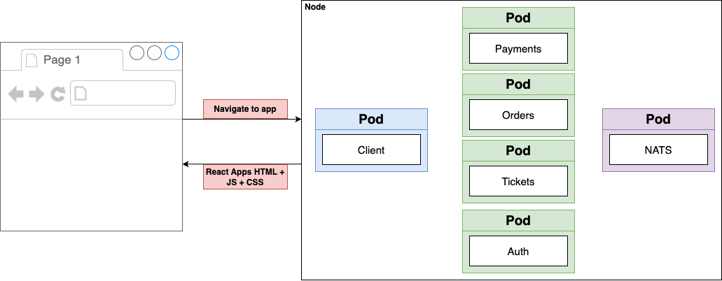
What we need

Slide 10
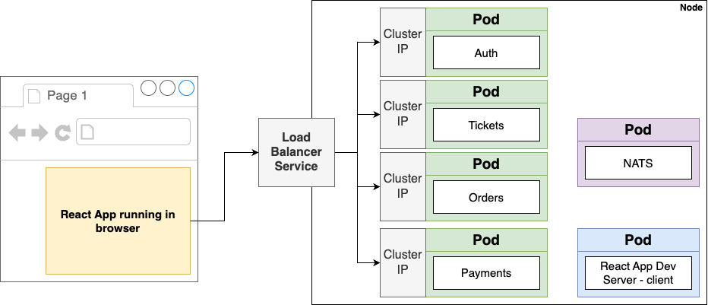
Tells Kubernetes to reach out to its provider and provision a load balancer. Gets traffic into a single pod

Slide 11
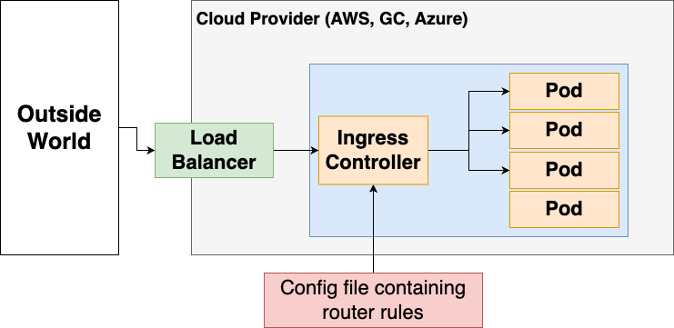
Ingress : A pod with a set of routing rules to distribute traffic to other services

Slide 12
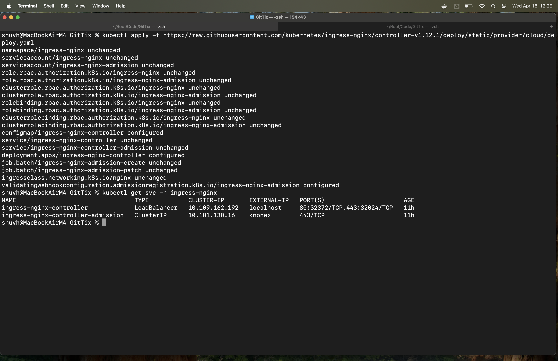
Demo && Screen Shots :
Ingress Service Setup

Slide 13
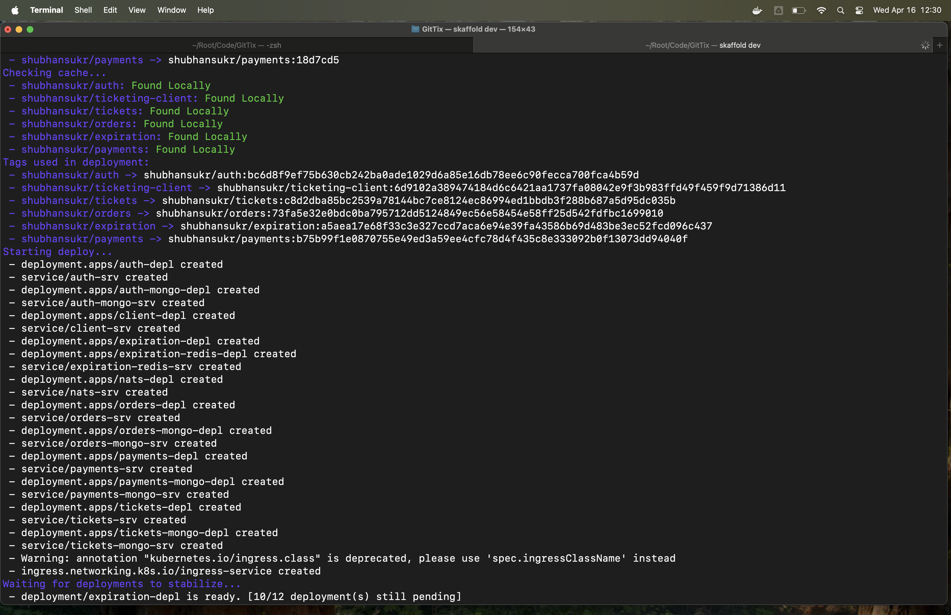
Deployment Started

Slide 14
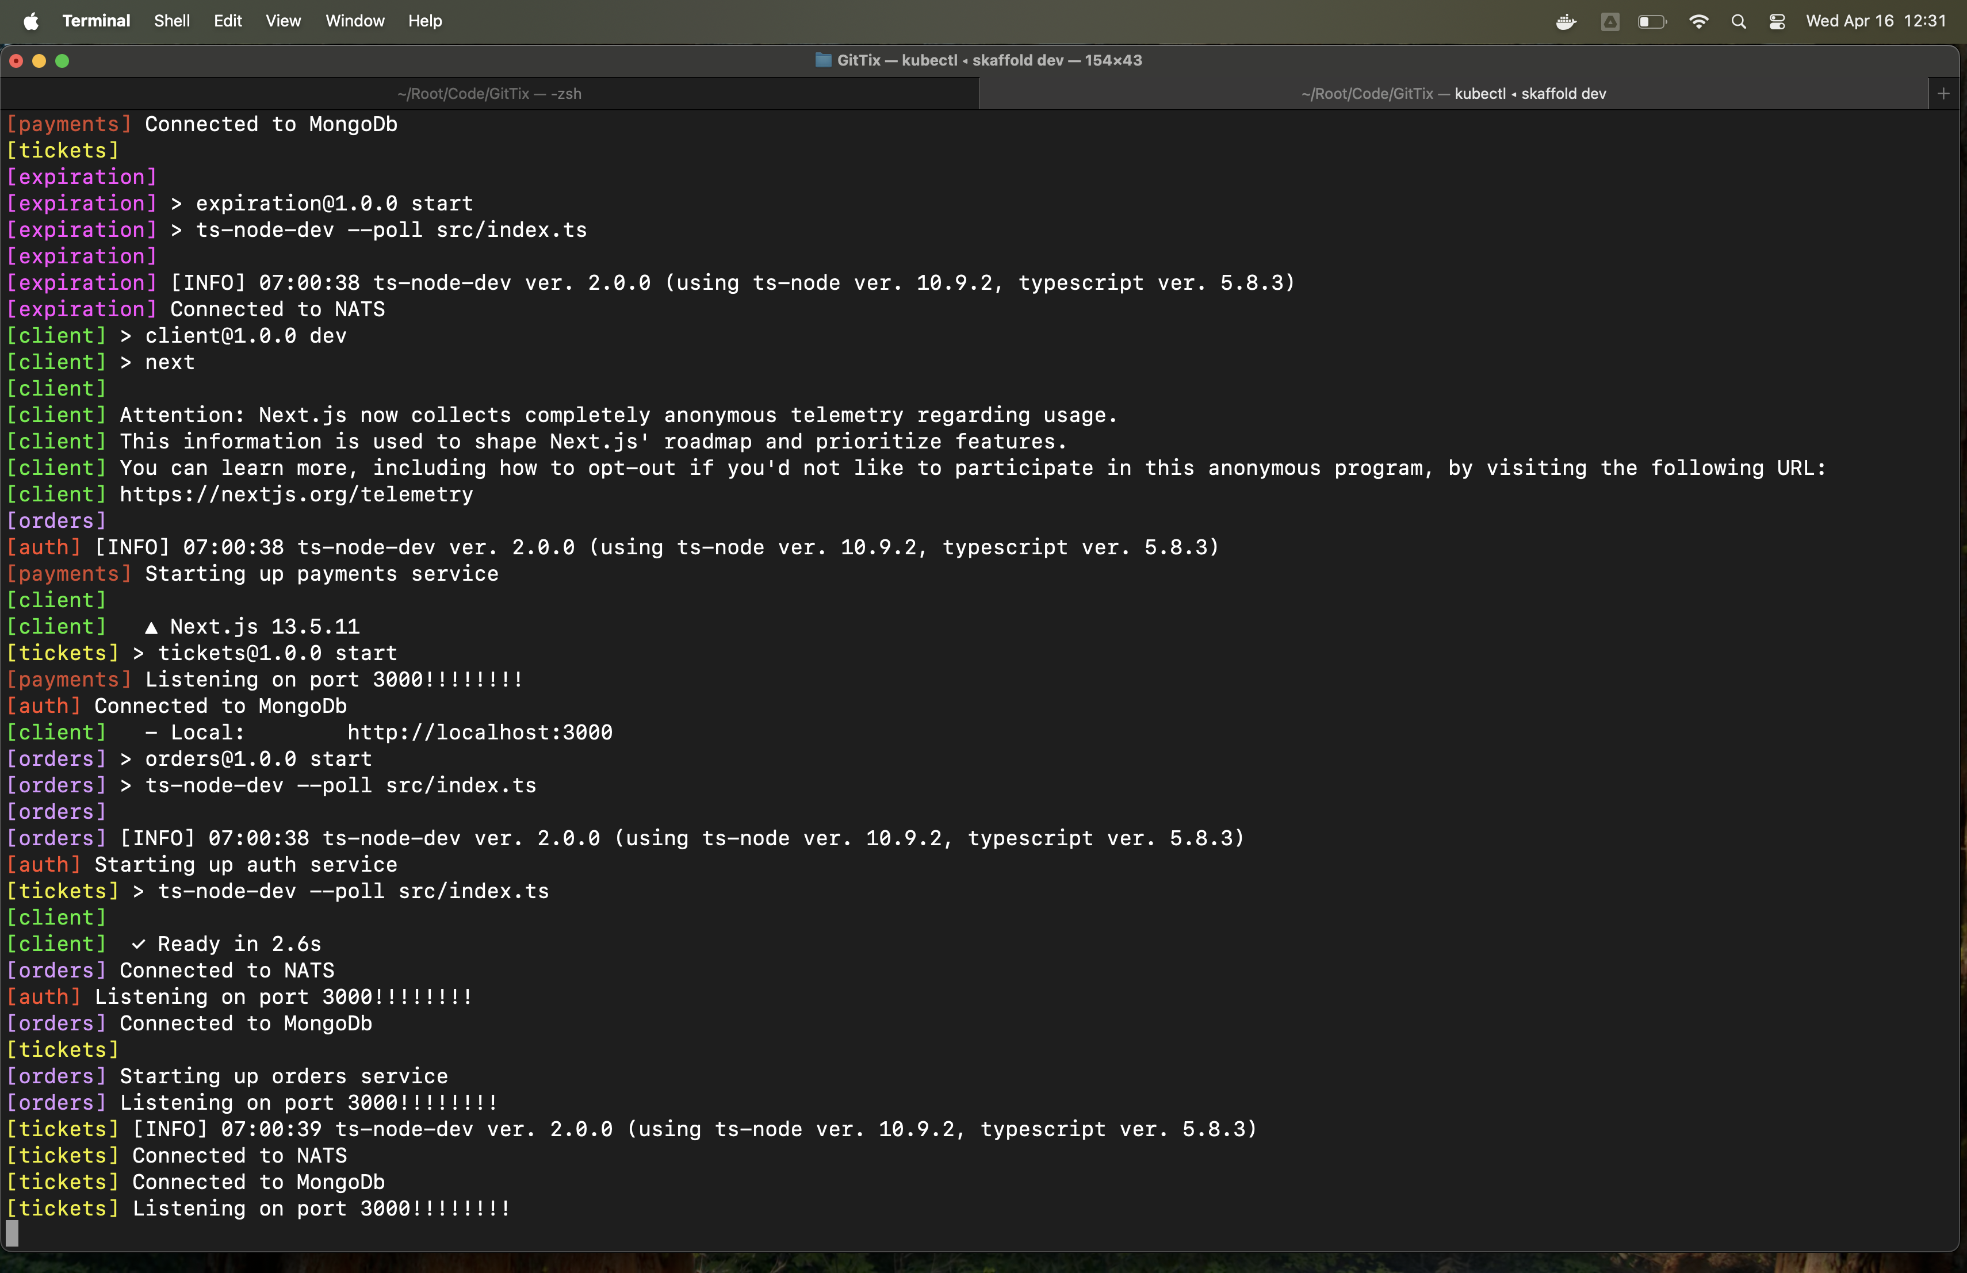
Application Logs

Slide 15
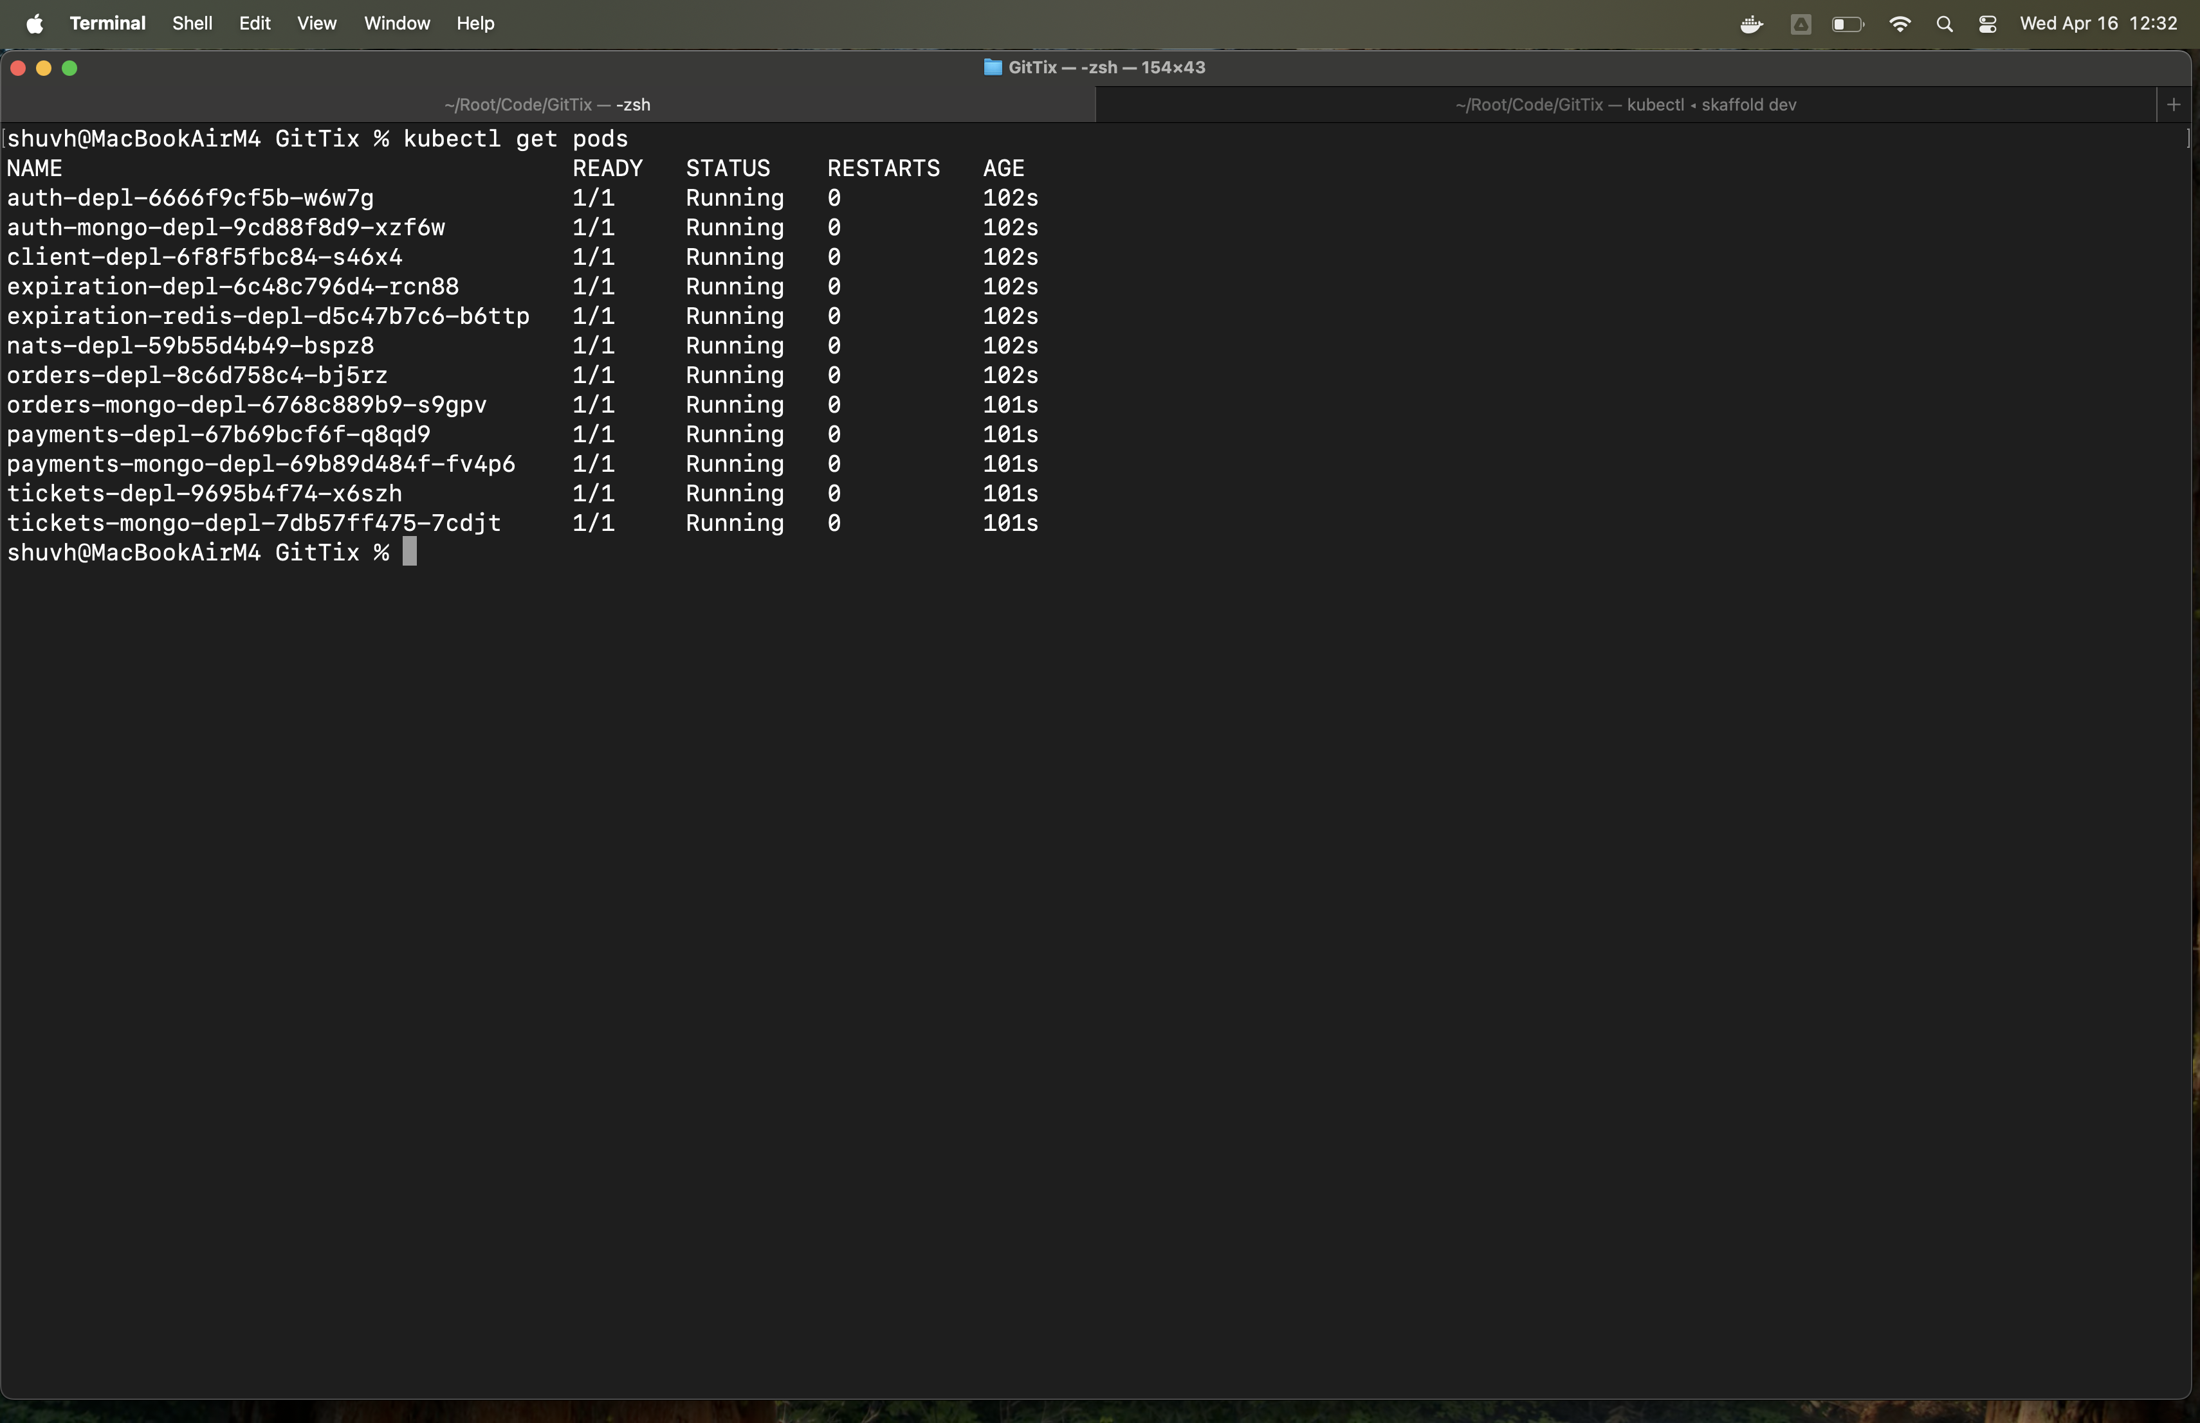
Kube Pods

Slide 16
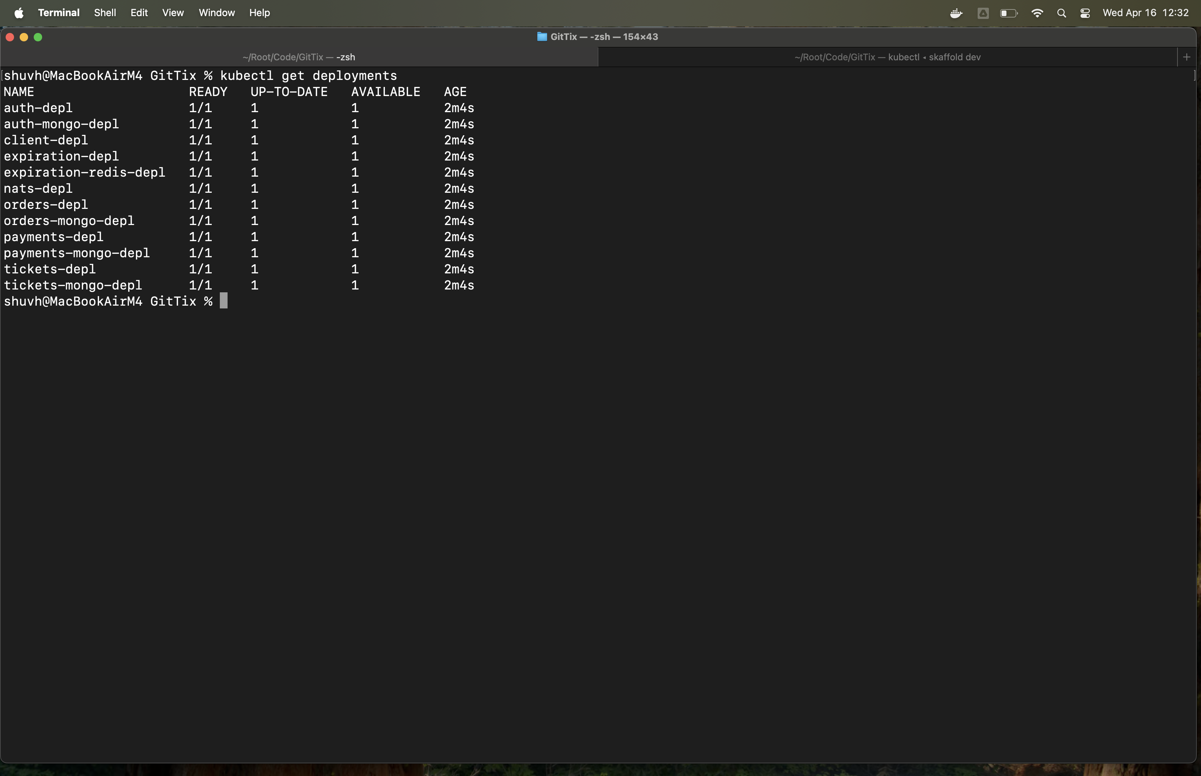
Kube Deployments

Slide 17
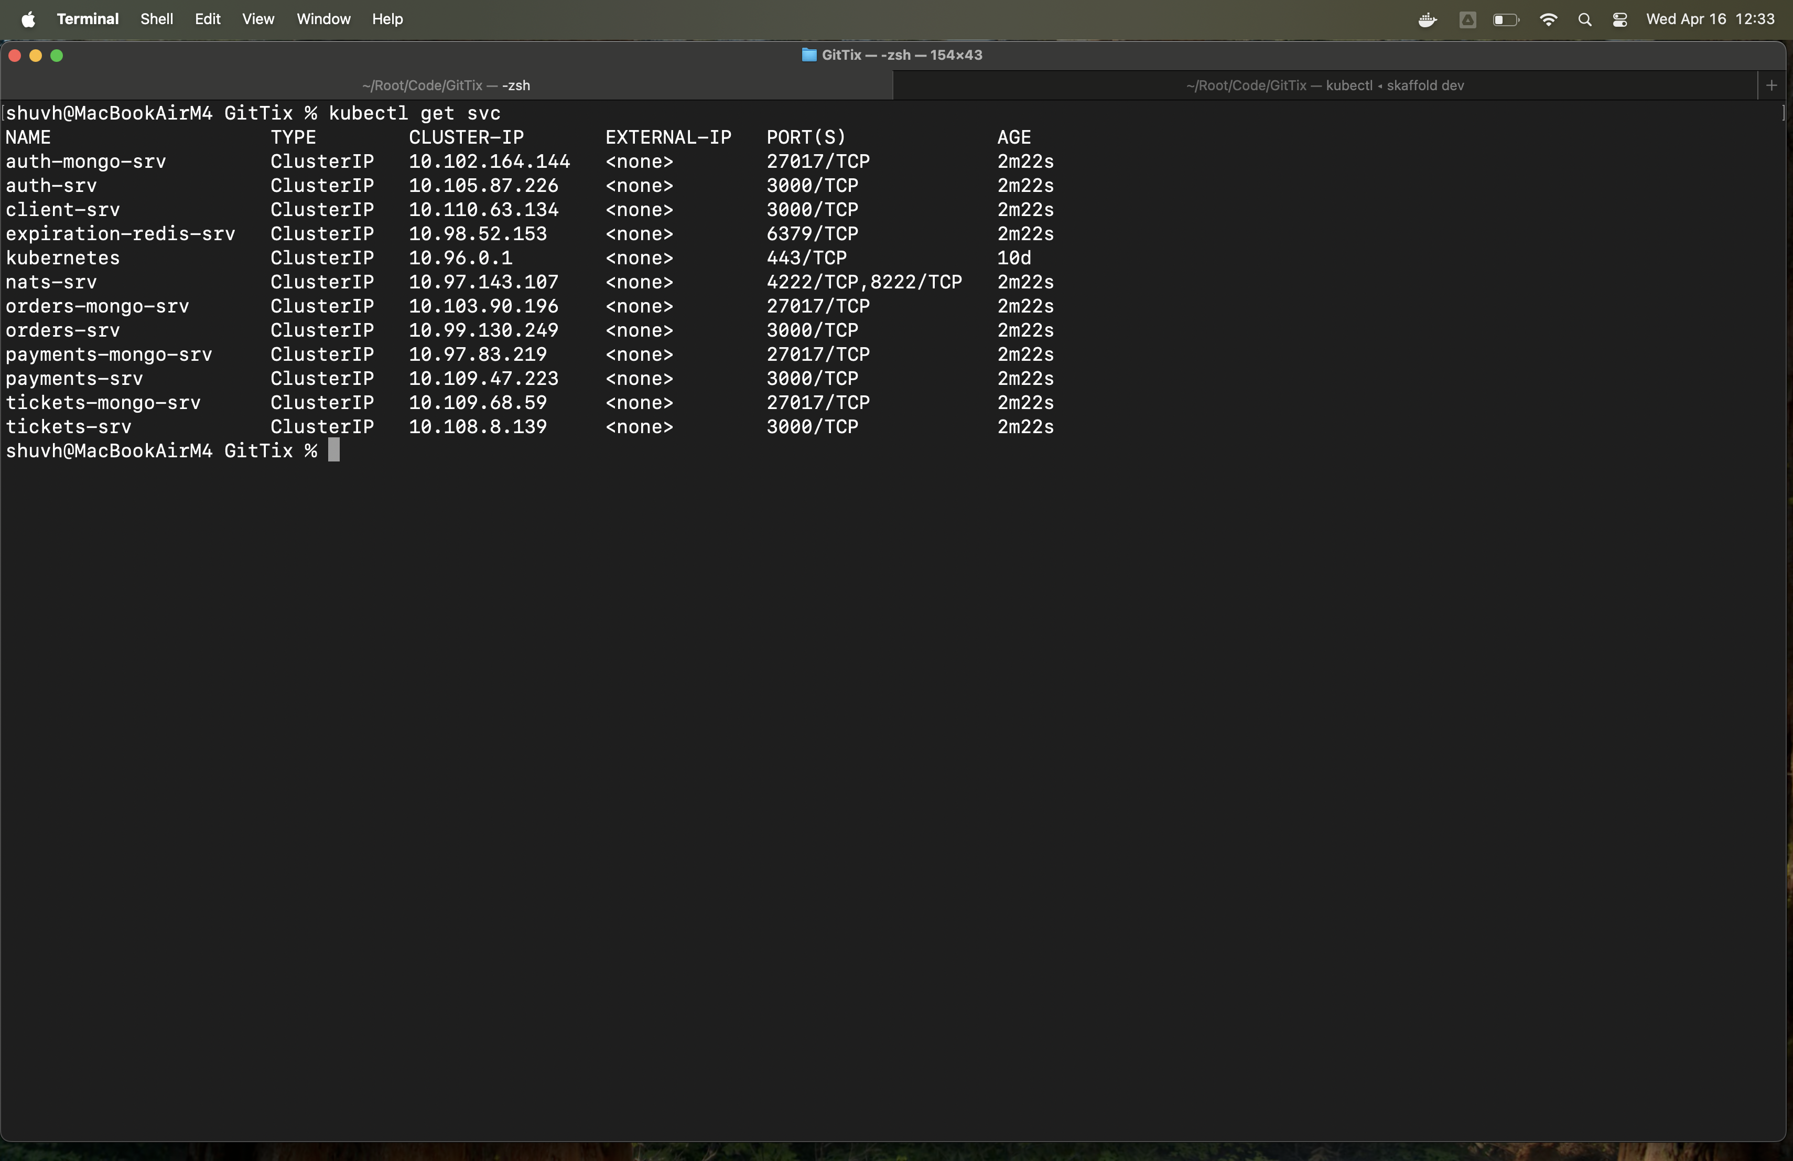
Kube Services

Slide 18
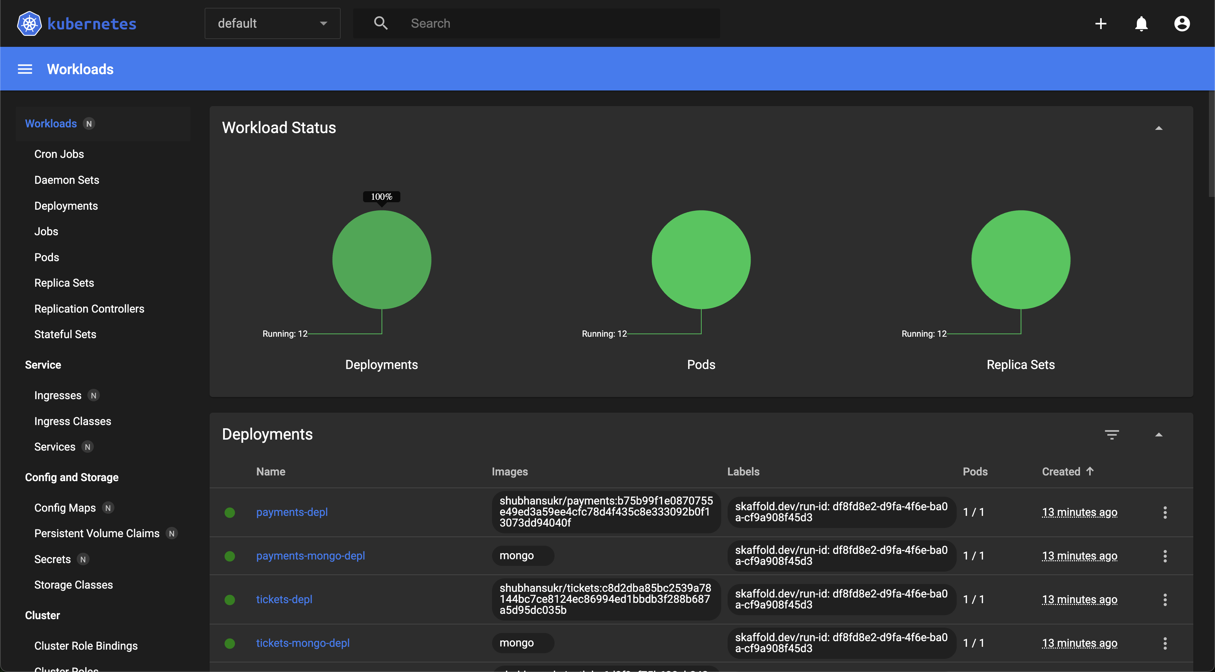

Slide 19
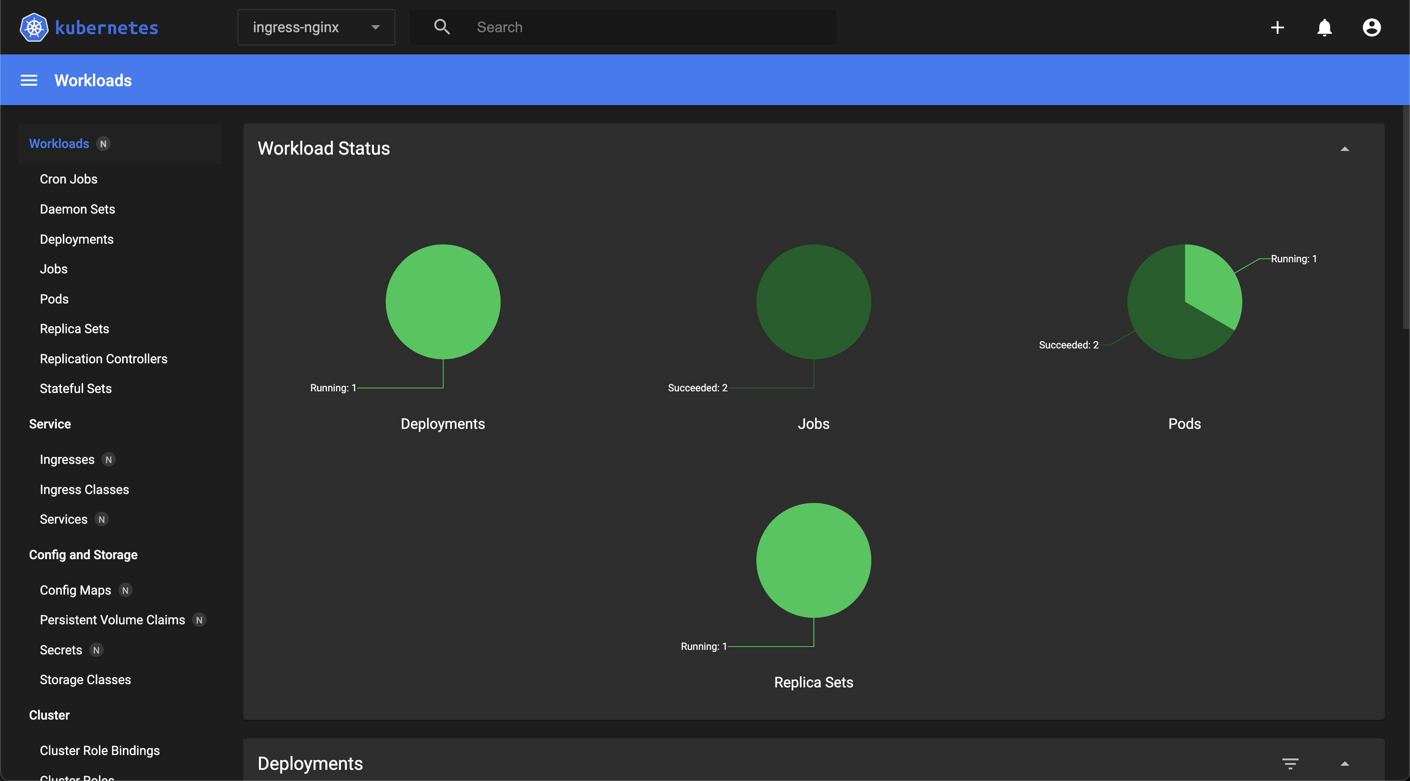

Slide 20
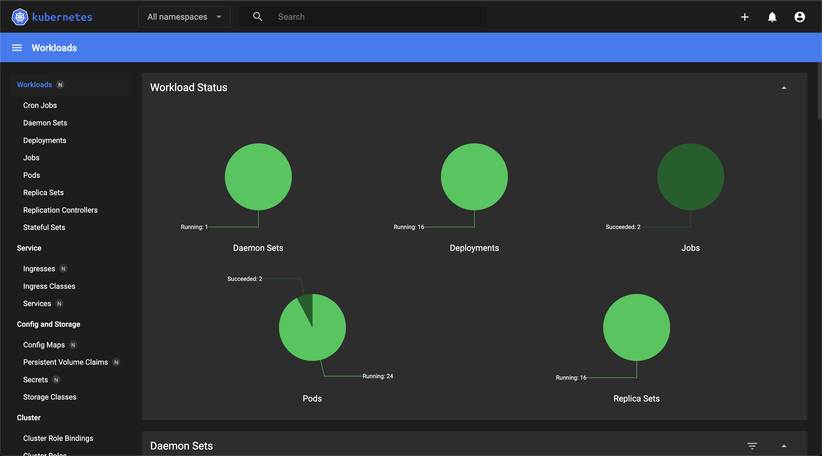

Slide 21
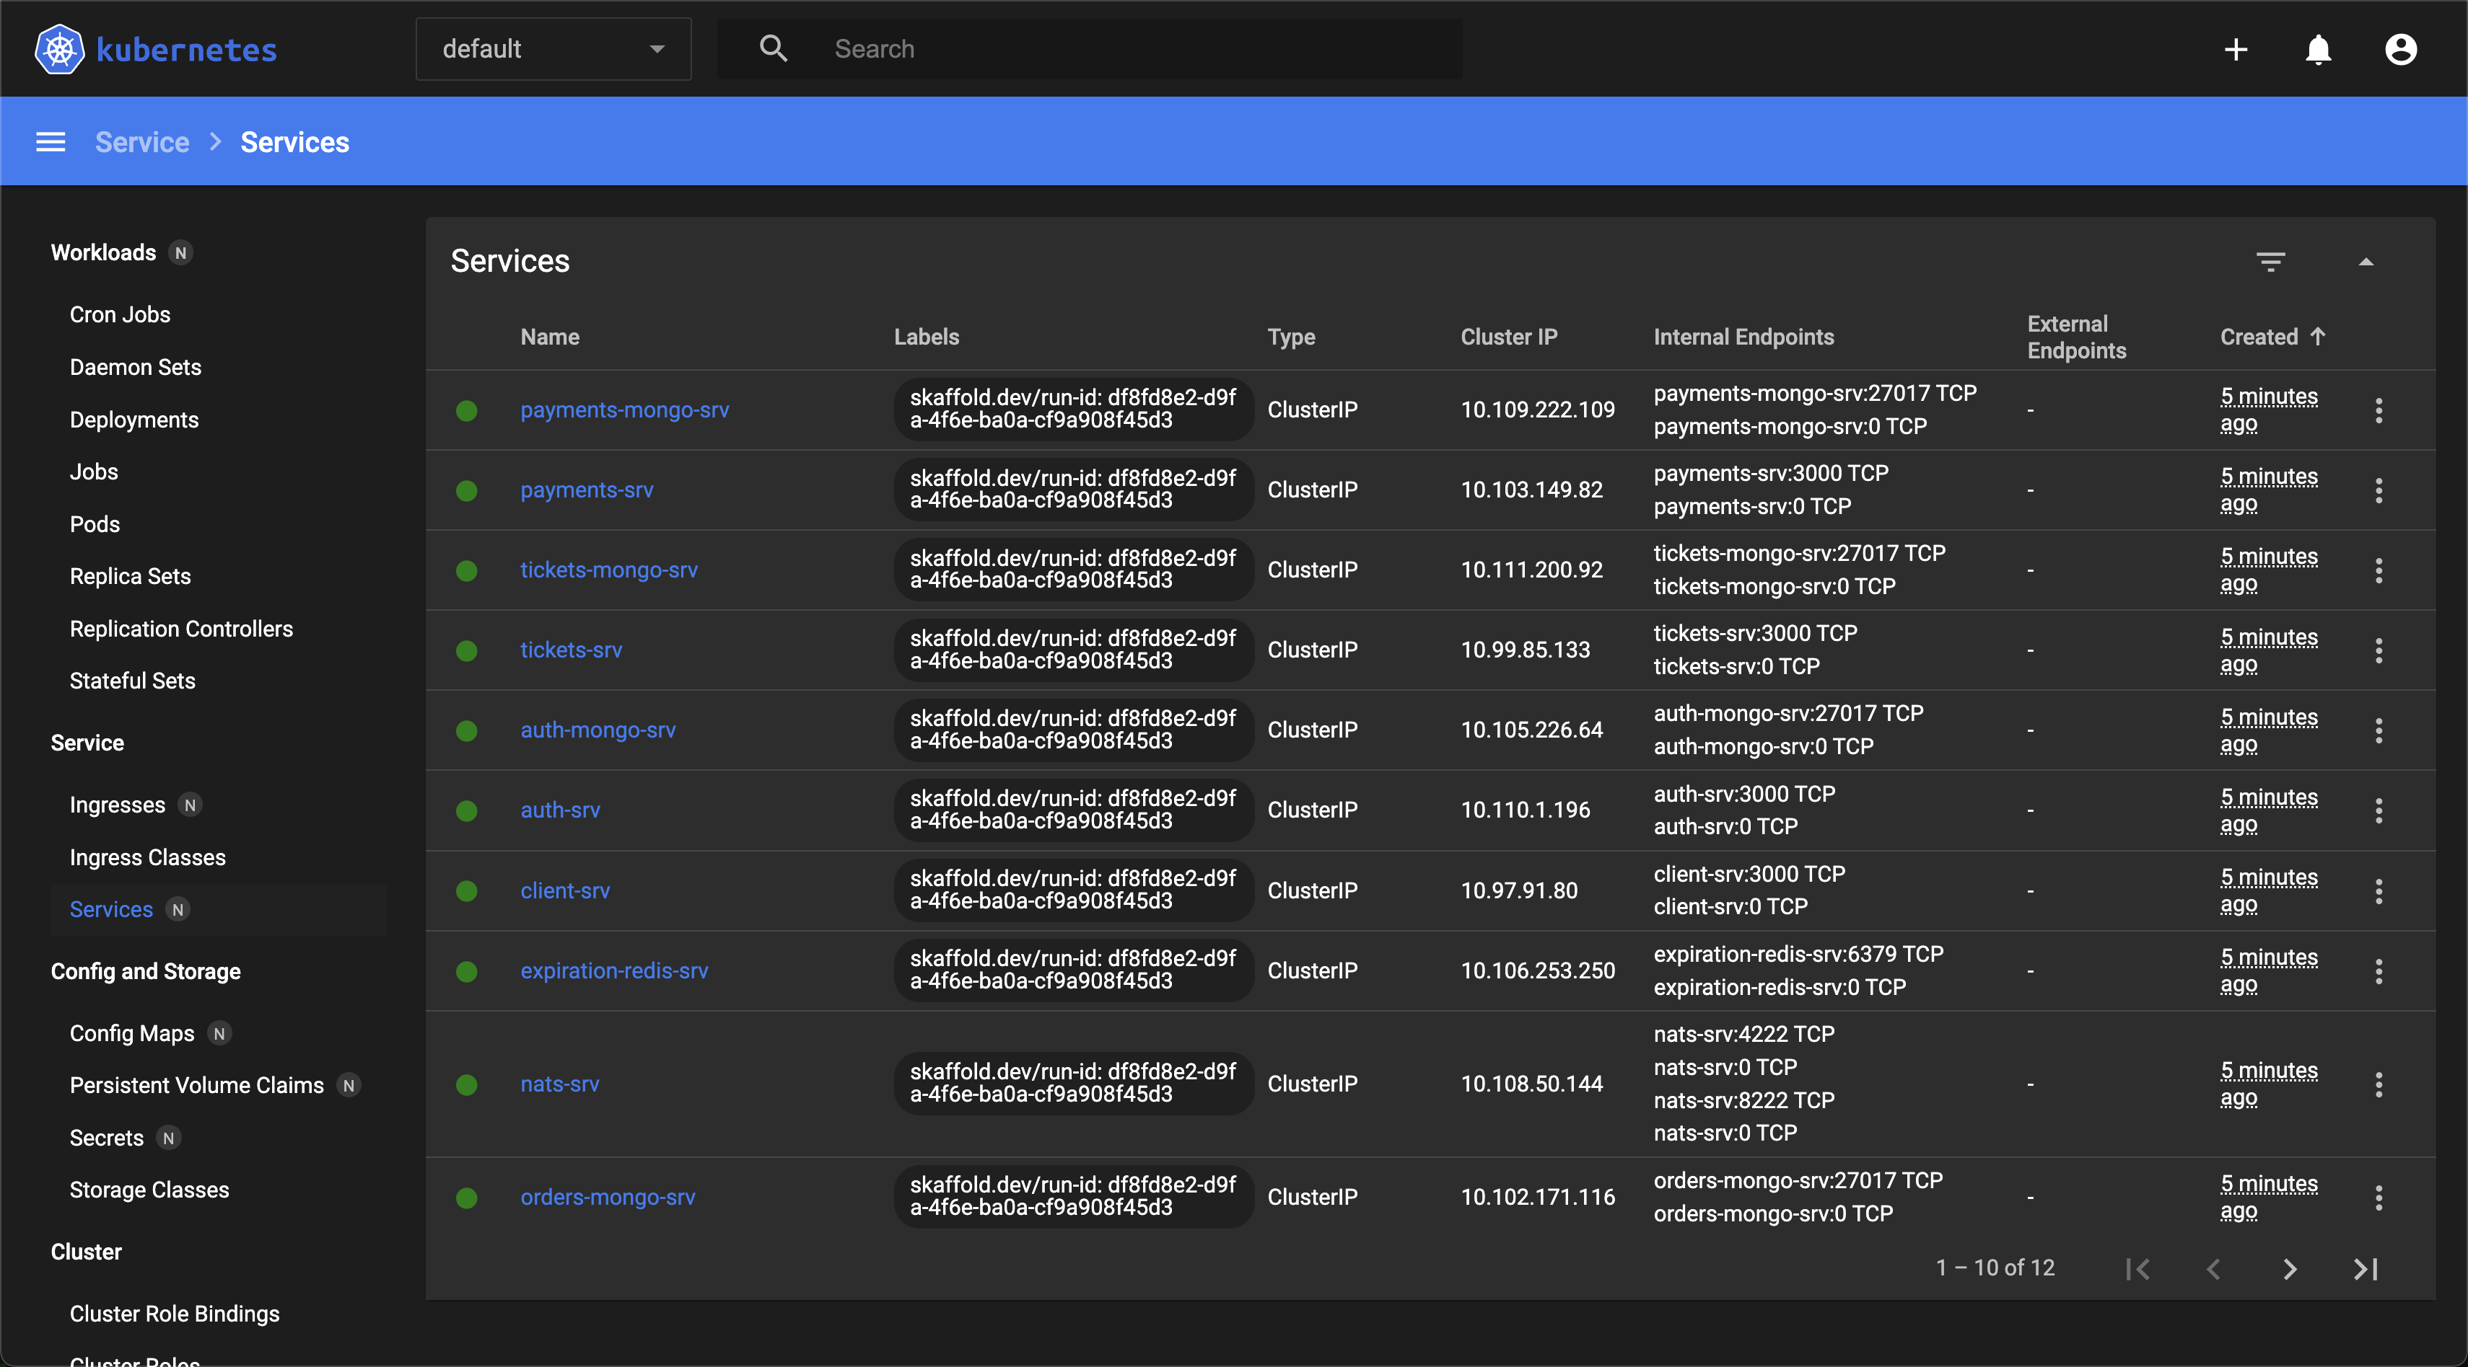

Slide 22
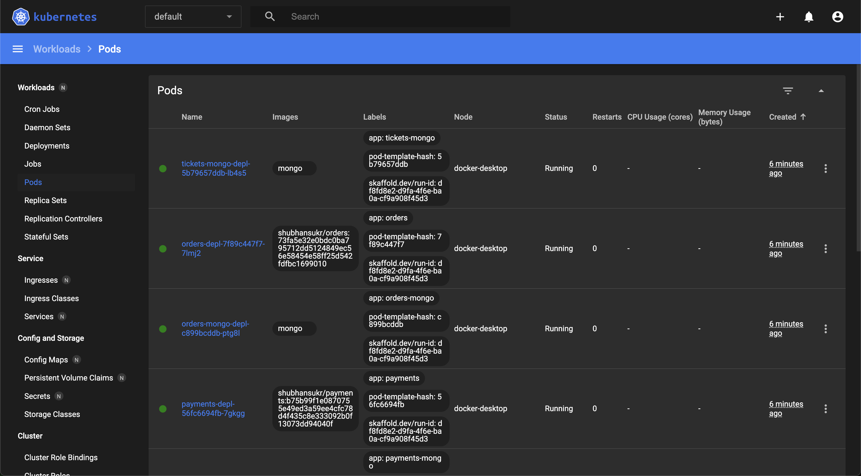

Slide 23
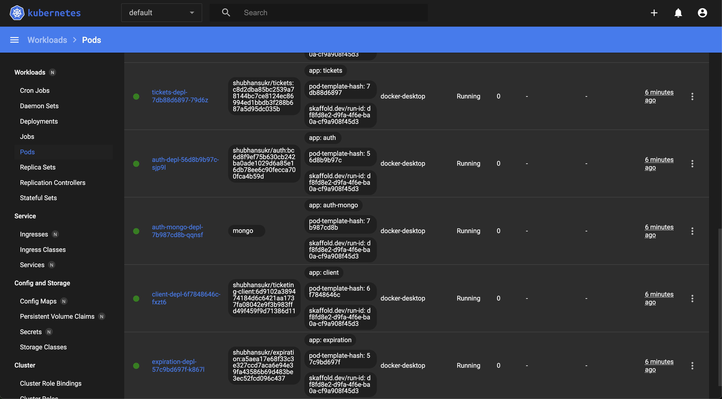

Slide 24
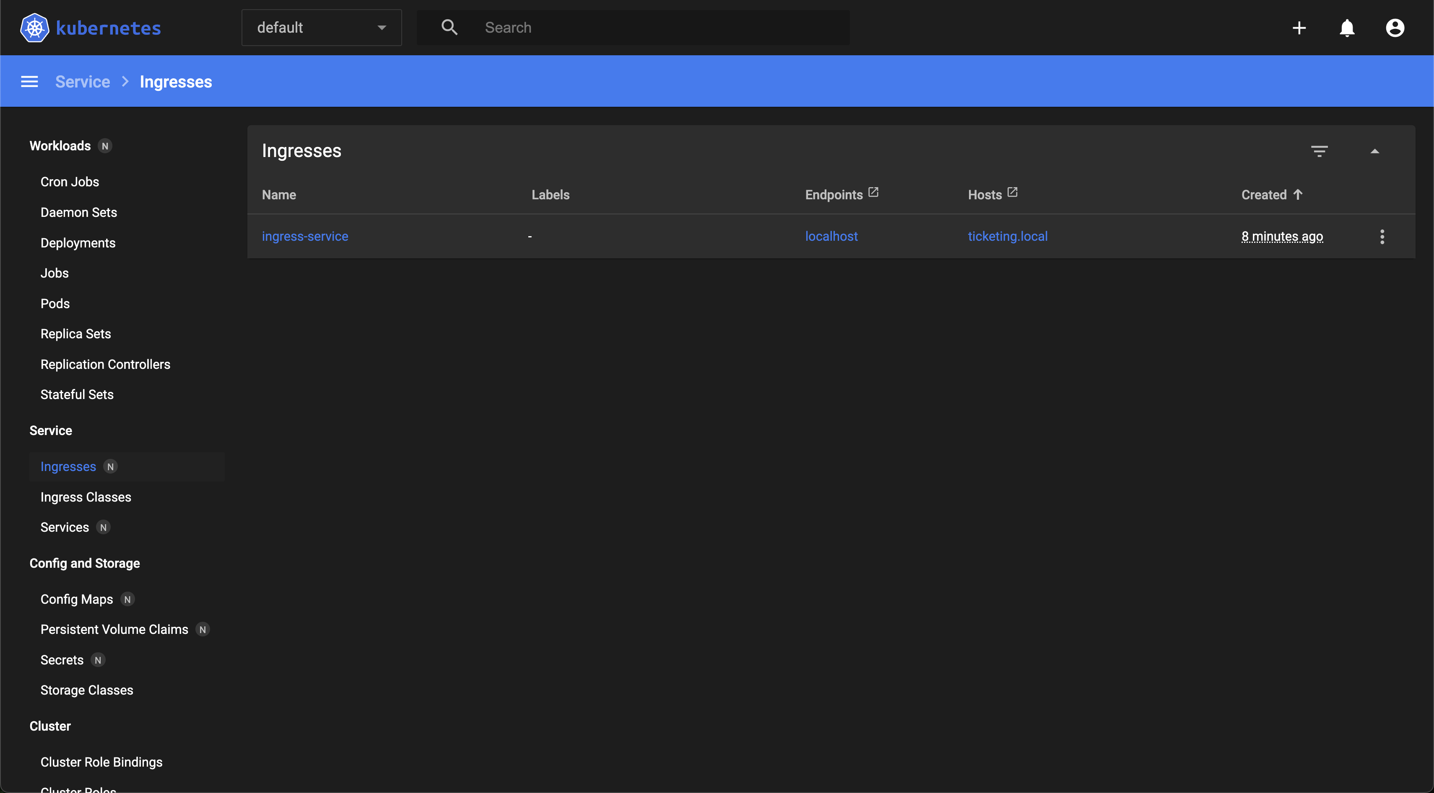

Slide 25
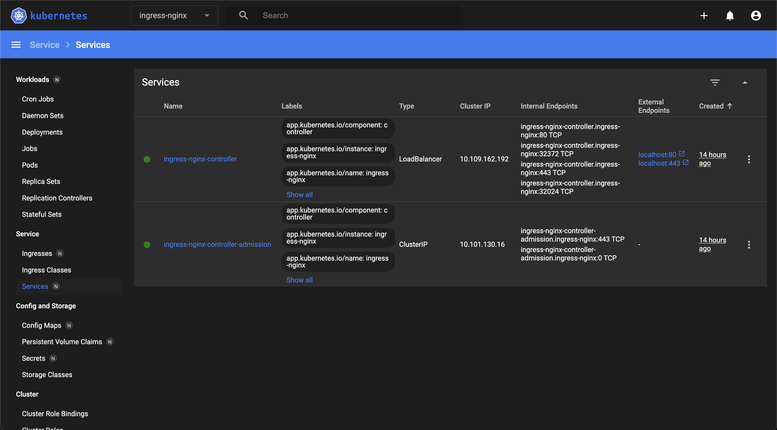

Slide 26
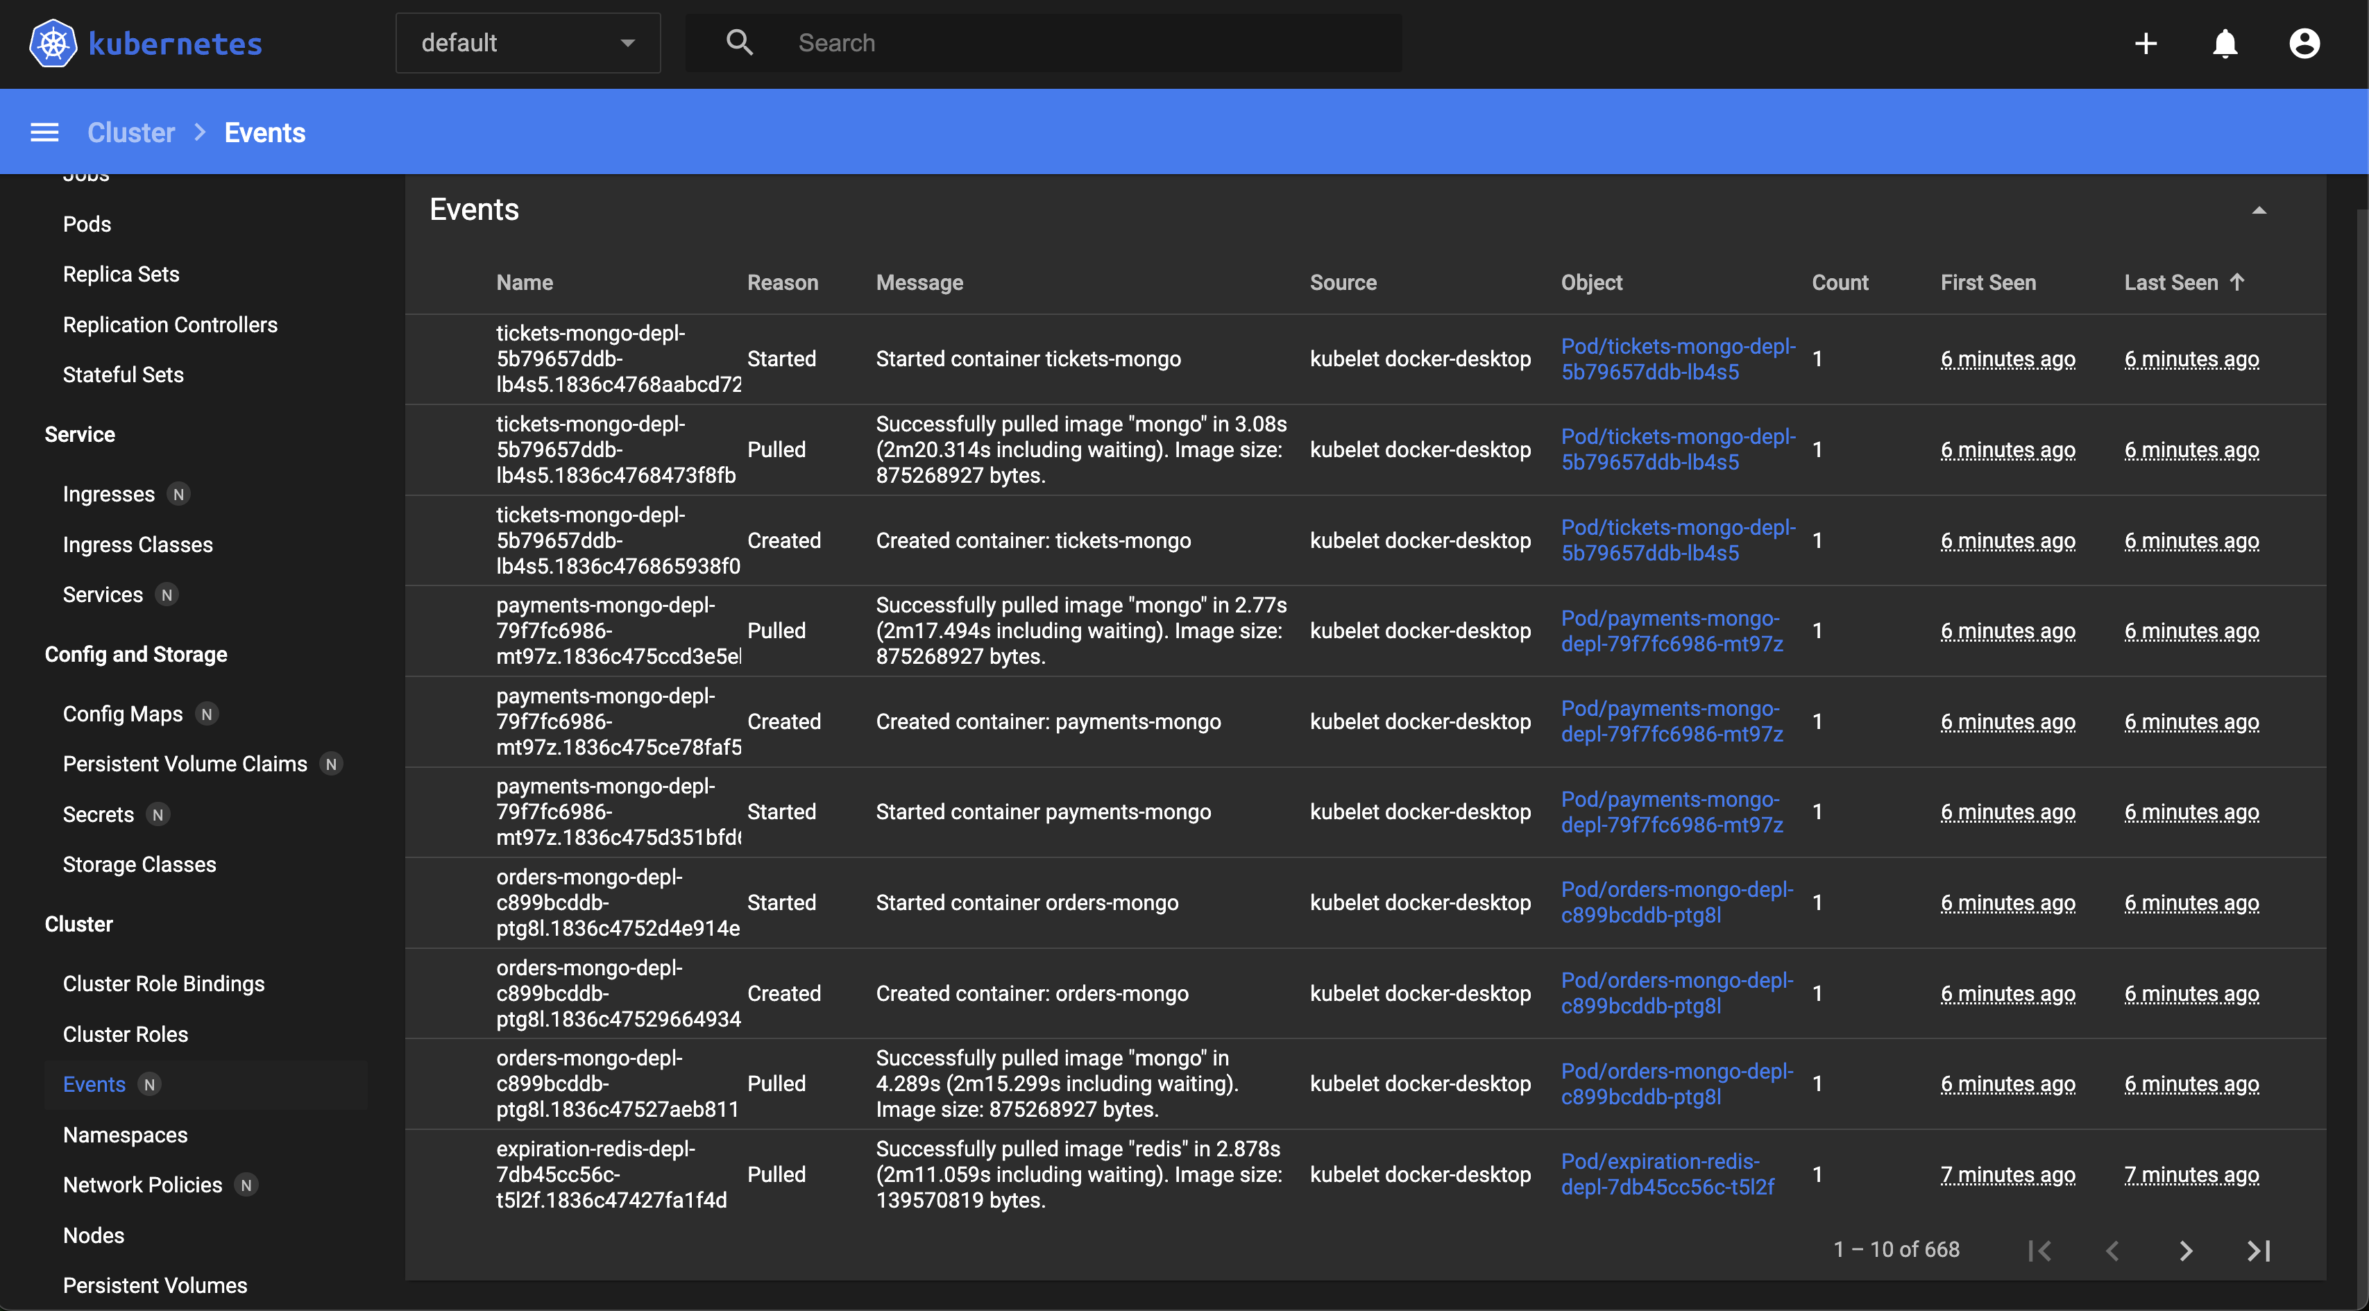

Slide 27
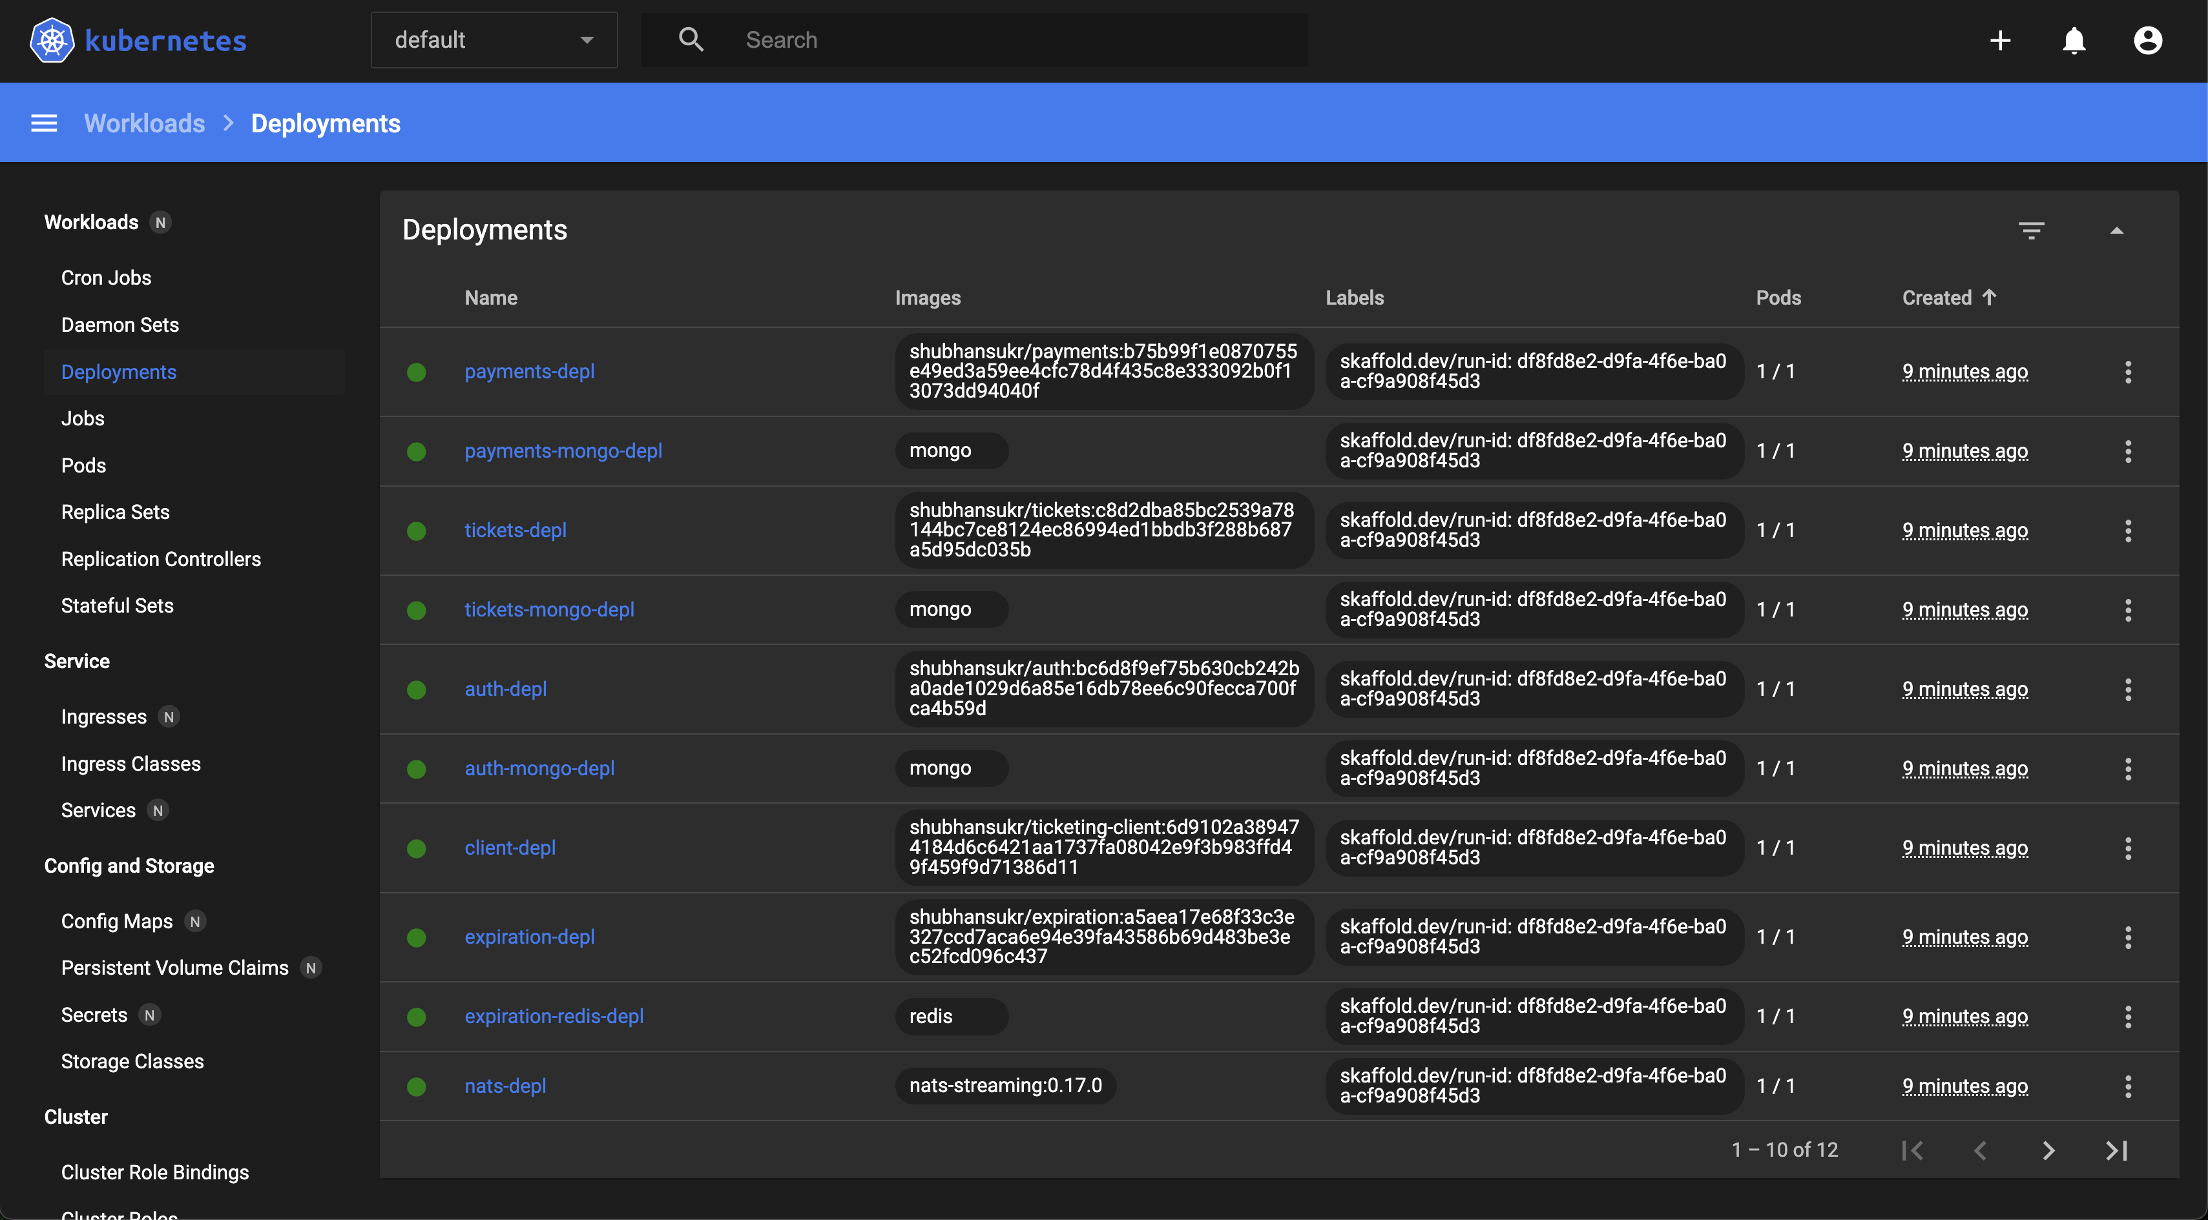

Slide 28
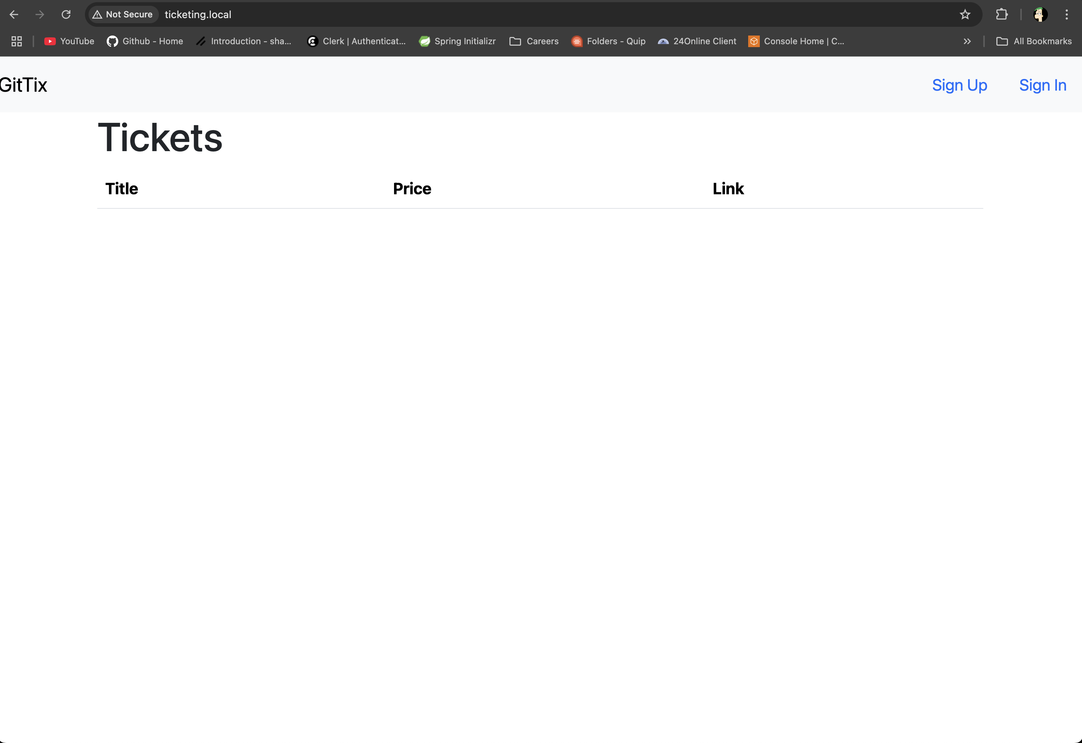
Client

Slide 29
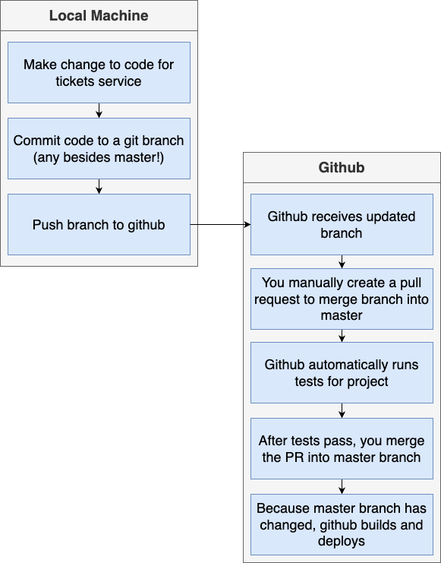
CI – CD Flow Diagram

Slide 30
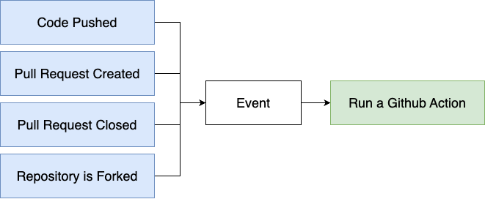
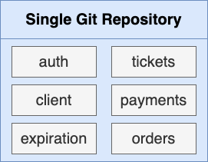

Slide 31
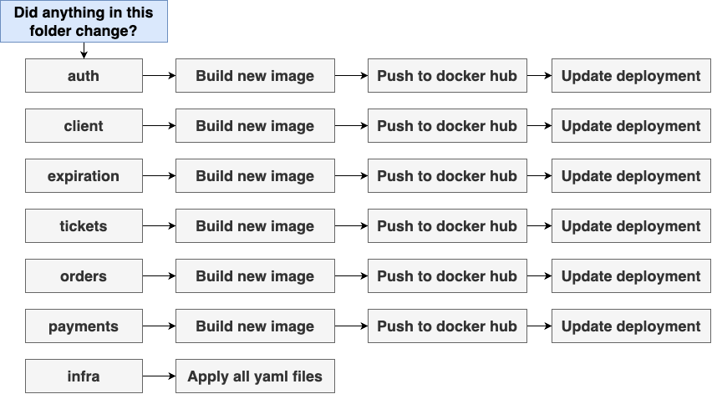

Slide 32
Code – Github Demo
https://github.com/shubhansu-kr/

Slide 33
Q & A
Github Repo : https://github.com/shubhansu-kr/Project-GitTix

